Slide 1

Testing stacked
Allan Grays approach on building quality software fast.

Slide 2


Be zombie proof
What we really want
Full control
Solid
Unexposed
Notes:
What we really want is to be zombie proof…
This to me paints a picture of how Id like testing to work…
A solid rigid structure… can let a few things in or out that I have full control over…

Slide 3

The balancing act
Maintaining stability
Constant change
Fragile but holding on.
Notes:
This kind of represents testing as a whole, a balancing act trying to maintain stability with a flood of features and constant change all around.
Its fragile yet if you get it just right it can be quiet resilient.
Don’t know weather you guys feel testing is like this in your company but I certainly do feel like this at AG.
We have a number of different technologies, layers and integration points that we have to test and we tend to keep adding yet another framework or a new tool or some new environment to test in.

Slide 4

Understanding the architecture
Web app
API 1
Client
API aggregation (BFF)
API 2
API 3
Data
Data
Data
API 4
Data
Data

Slide 5

API micro services
Scala (build)
Integrated tests with mocked dependencies
JS (periodically)
Integrated tests
Tests that check contracts

Slide 6
API micro services
Cover basic success and error paths through the integration module.
Repository connections and error handling.
The correct data is returned.

Slide 7






Slide 8

Web app
JS (build)
Acceptance tests - mocked (mocha)
API aggregation - Bff (post deploy)
Integrated tests
Tests that check contracts

Slide 9
Web app
Test all permutations/states of the component.
User journeys and interactions.
Fully mocked.
Runs with build
Bff integration to independently test service.
JSON structure and data types are correct.

Slide 10









REACCEPTANCE

Slide 11
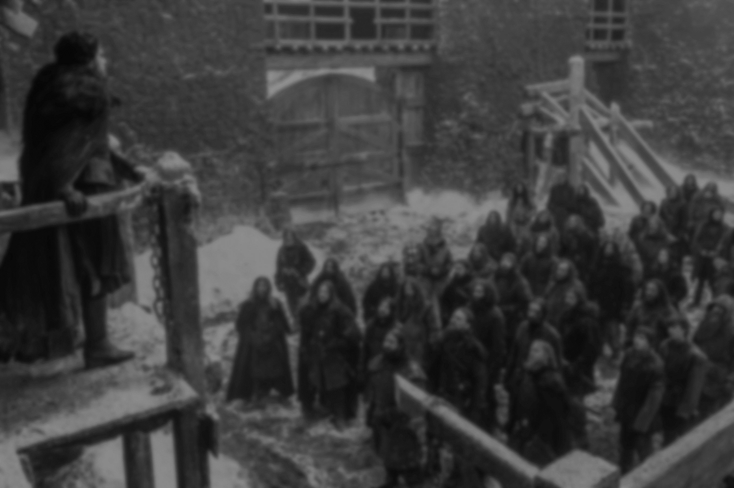
NightWatch
JS (post deploy)
Via client
End to End (E2E)
X-Browser capability
Multi threaded

Slide 12
NightWatch
Are all services and apps are talking to each other successfully.
Quantity: "Happy day" and one or two negative test cases.
No stubs or mocks.
E2E tests are there as a second line of test defense.
Add tests further down.
E2E tests are expensive.

Slide 13





Slide 14


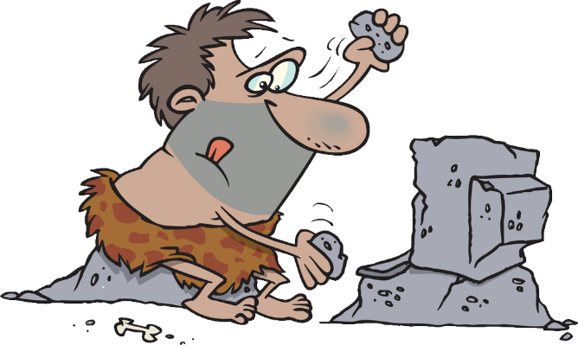
Manual verification
REACCEPTANCE

Slide 15
Next
Start a series
Confusing ideas? Lets talk

